Slide 1
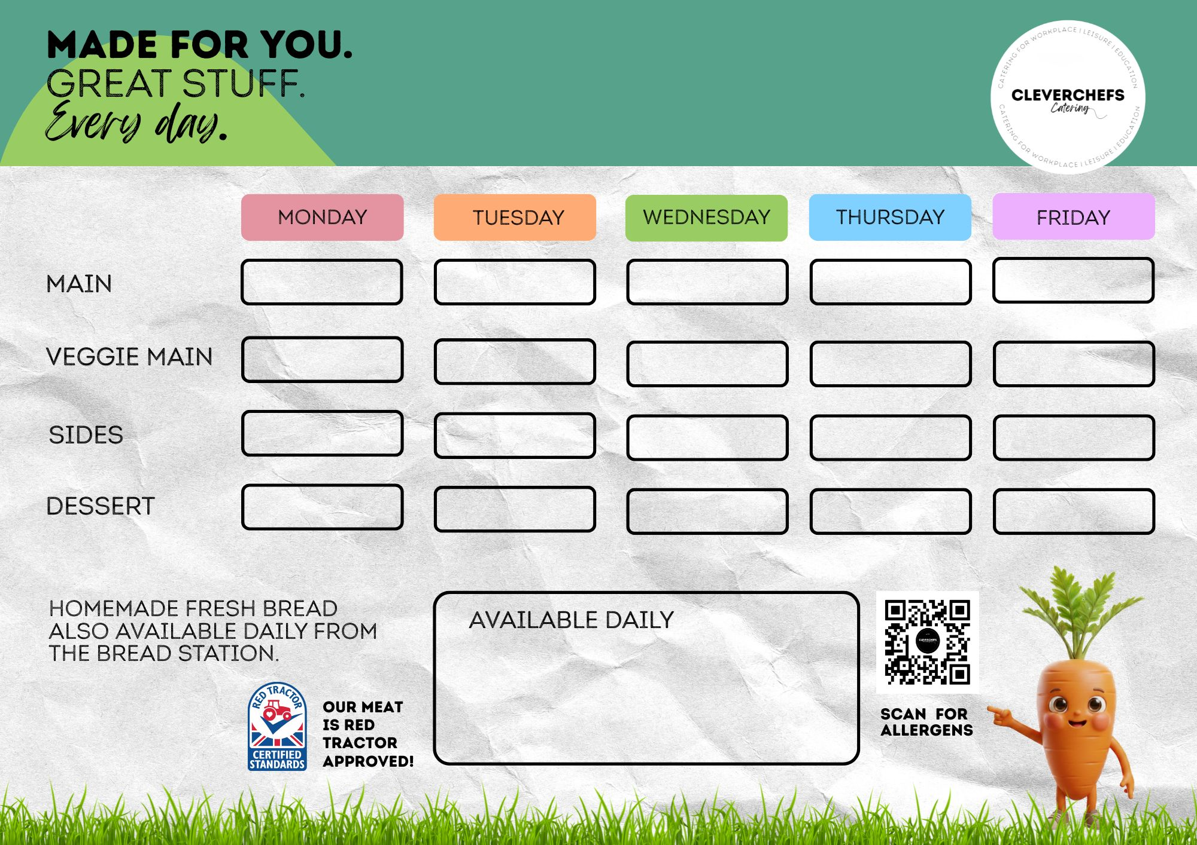
PASTA BOLOGNAISE
CHICKEN CURRY AND RICE
ROAST CHICKEN AND GRAVY
MARGHERITA PIZZA
FISH FINGERS
AND CHIPS
VEGGIE PASTA BOLOGNAISE
VEGETABLE CURRY AND RICE
VEGGIE SAUSAGES
VEGGIE SUPREME PIZZA
VEGGIE NUGGETS AND CHIPS
SALAD
BROCCOLI
ROASTIES, CARROTS, PEAS
SALAD
PEA OR BEANS
DESSERT OF THE DAY
DESSERT OF THE DAY
DESSERT OF THE DAY
DESSERT OF THE DAY
DESSERT OF THE DAY
JACKET POTATOES: CHEESE/BEANS/TUNA
SALAD BAR: LETTUCE, CARROT, CUCUMBER, TOMATO
FRESH FRUIT:
Week 1
31/08, 21/09, 12/10, 02/11, 23/11, 14/12, 04/01, 25/01, 15/02
our meat is red tractor approved!

Slide 2
SAUSAGE PASTA
BBQ CHICKEN WRAP
ROAST CHICKEN AND GRAVY
HOT DOG
FISH FINGERS AND CHIPS
PESTO PASTA
BBQ CHEESE WRAP
CHEESE AND ONION PASTRY POCKET
VEGGIE HOT DOG
VEGGIE NUGGETS AND CHIPS
BROCCOLI
SWEETCORN
ROASTIES, CARROTS, PEAS
HOMEMADE WEDGES, SALAD
PEA OR BEANS
DESSERT OF THE DAY
DESSERT OF THE DAY
DESSERT OF THE DAY
DESSERT OF THE DAY
DESSERT OF THE DAY
JACKET POTATOES: CHEESE/BEANS/TUNA
SALAD BAR: LETTUCE, CARROT, CUCUMBER, TOMATO
FRESH FRUIT:
Week 2
07/09, 28/09, 19/10, 09/11,
30/11, 21/12, 11/01, 01/02
our meat is red tractor approved!

Slide 3
CHICKEN AND SWEETCORN PASTA
BEEF
LASAGNE
ROAST CHICKEN
AND GRAVY
SAUSAGE AND MASH
FISH FINGERS AND CHIPS
MAC N CHEESE
MIXED BEAN
LASAGNE
VEGGIE QUICHE
VEGGIE SAUSAGE AND MASH
VEGGIE NUGGETS AND CHIPS
CAULIFLOWER
SWEETCORN
ROASTIES, CARROTS, PEAS
GREEN BEANS
PEA OR BEANS
DESSERT OF THE DAY
DESSERT OF THE DAY
DESSERT OF THE DAY
DESSERT OF THE DAY
DESSERT OF THE DAY
JACKET POTATOES: CHEESE/BEANS/TUNA
SALAD BAR: LETTUCE, CARROT, CUCUMBER, TOMATO
FRESH FRUIT:
Week 3
14/09, 05/10, 26/10, 16/11, 07/12, 28/12, 18/01, 08/02

