Slide 1

Meet our team:
Lions – Miss O’Brien
Support Staff – Mrs Greenwood, Mrs Platt and Miss Allen
Tigers – Mrs Masters and Mrs Turner (Wednesday)
Support Staff – Mrs Saggi

Slide 2


Slide 3
Typical School Day
08:35 - School gate opens
08:40 - Morning Task
09:00 - Guided Reading
09:20 - Collective Worship
09:45 - Phonics and English
10:45 - Break
11:00 - Maths
12:00 - Lunch
12:45 - Meditation and handwriting
13:00 - Daily PSHE
13:15 - Mastering Number
13:30 - Foundation lessons
14:45 - Class story and reflection
15:10 - Home Time
Children will walk into class on their own by 8:40 and will be dismissed from the classroom at 15:10.

Slide 4
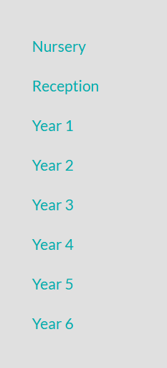
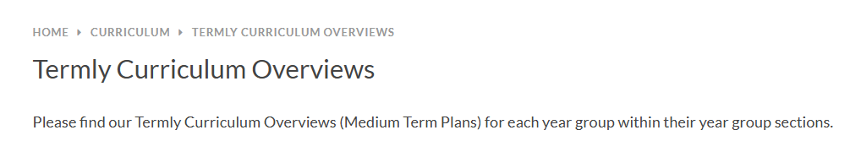
Termly Curriculum Overviews
https://www.stmarys-byfleet.surrey.sch.uk/page/?title=Termly+Curriculum+Overviews&pid=119

Slide 5
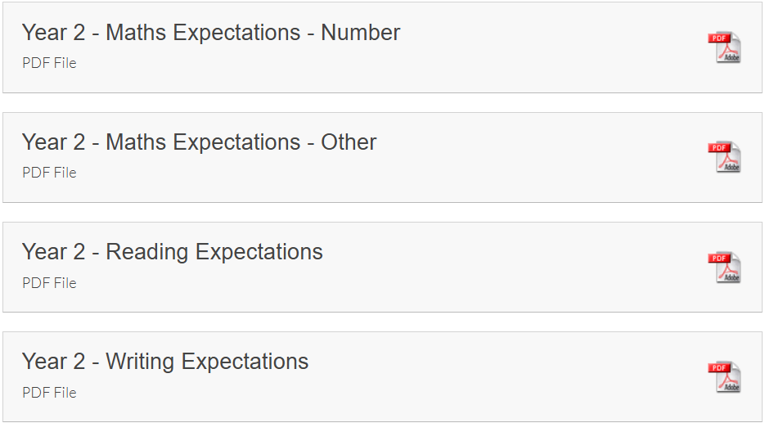
End of Year Expectations
https://www.stmarys-byfleet.surrey.sch.uk/page/?title=End+of+Year+Expectations&pid=513
National Curriculum.

Slide 6
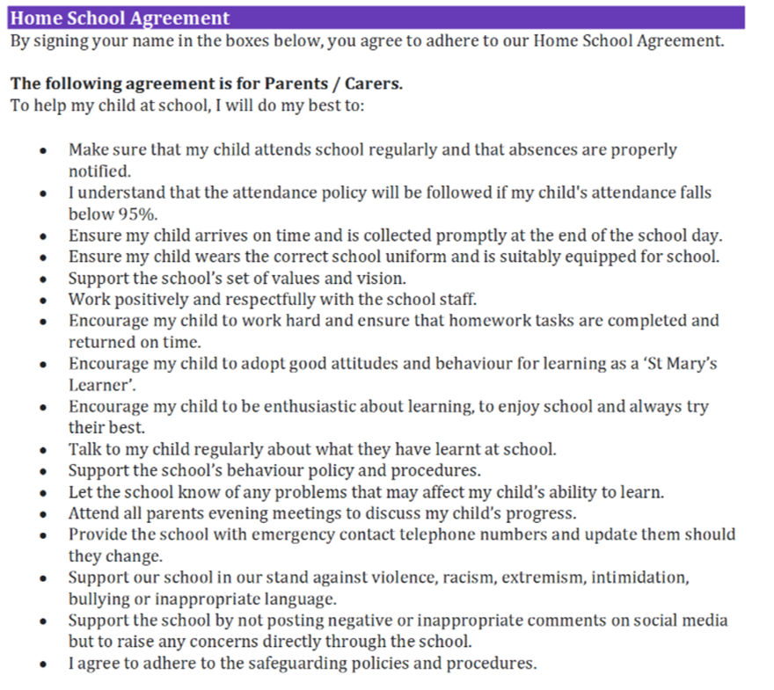
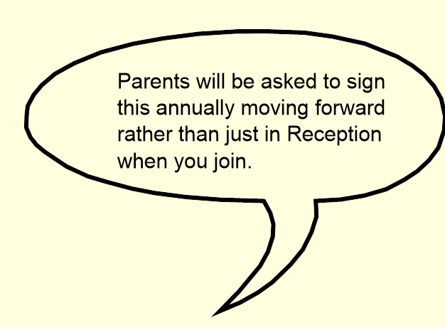

Slide 7
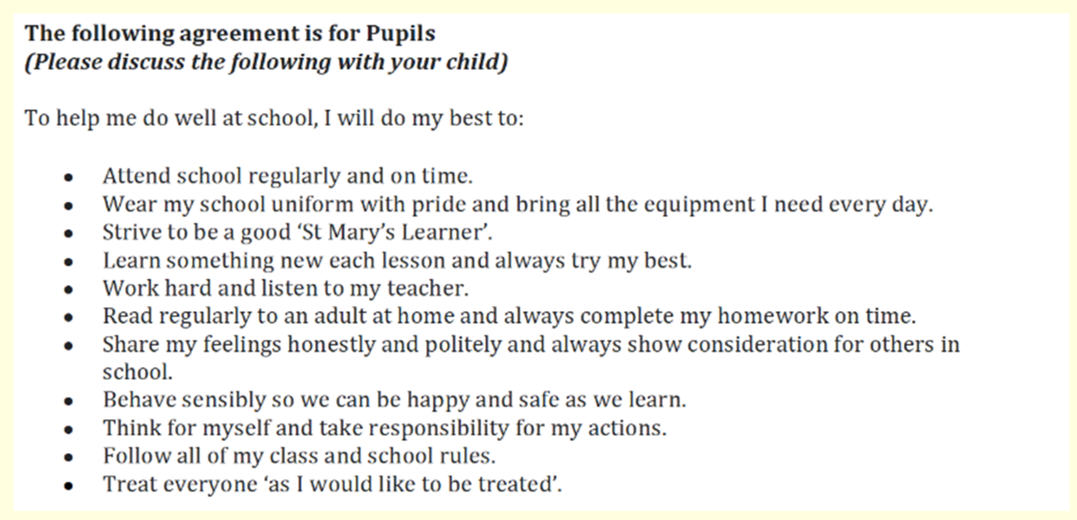
Support meetings will be put in place for families that are finding it challenging to consistently adhere to the home school agreement.
Your home/school agreement will be sent out via email shortly.

Slide 8
Homework expectations
Reading x 5 weekly
Weekly spelling list in reading record
Weekly spelling handwriting
Comprehension booklet
Numbots
Homework and reading records to be handed in on a Thursday.
If homework is not completed, children will be expected to do this during their own time at school.
https://play.numbots.com/#/intro

Slide 9
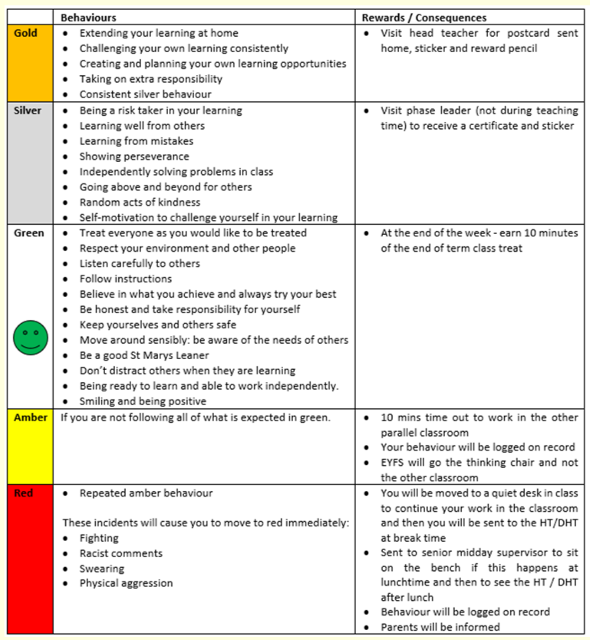
Behaviour Policy
Green time

Slide 10
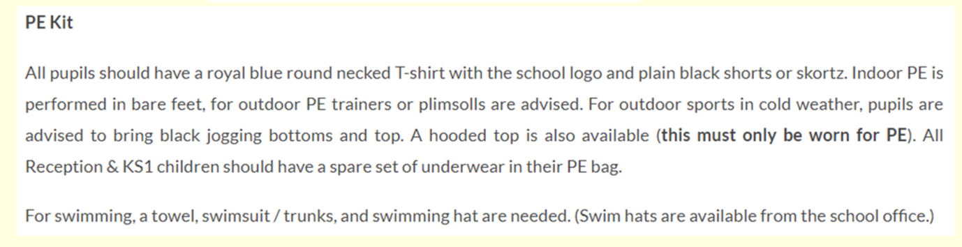
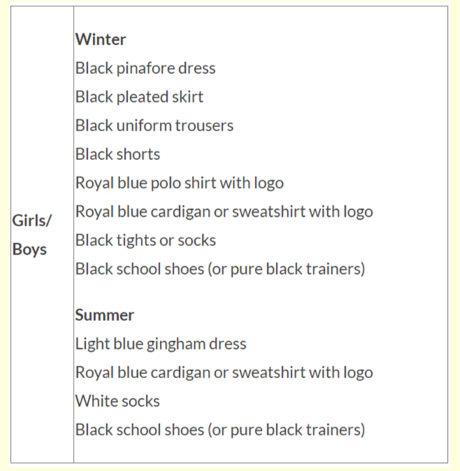
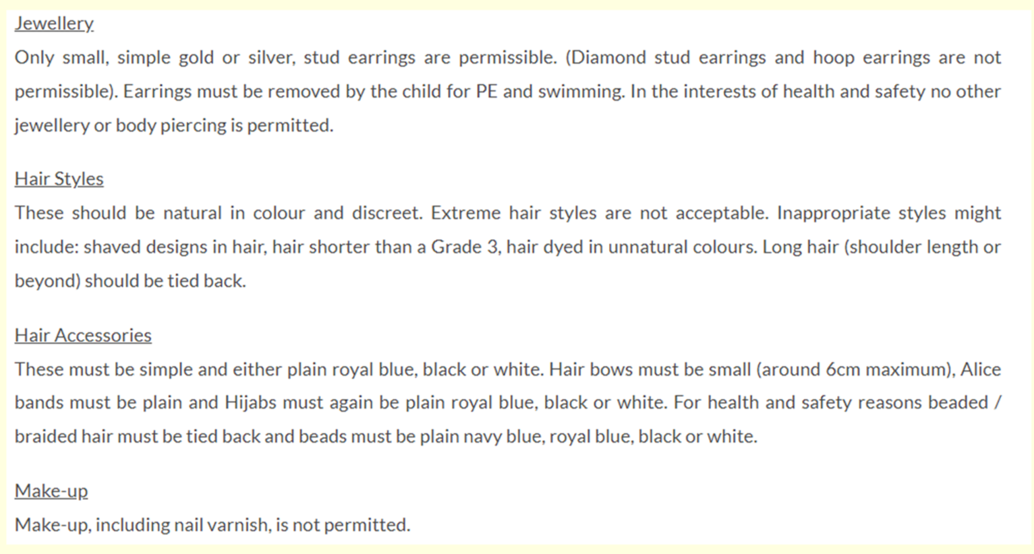
Uniform

Slide 11
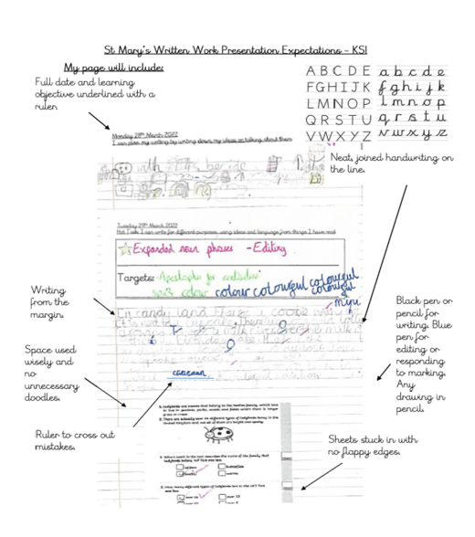
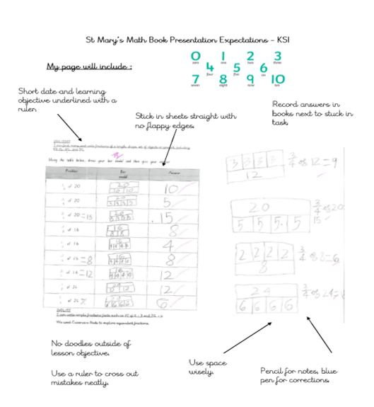

Slide 12
Rewards
Dojos
Silver/gold certificates
Whole-school reward stars for values
Star of the Week
Consequences
If the presentation policy is not followed, children will be expected to rewrite their work.
If doodles/drawings/graffiti are found, children will be sent to a senior leader.

Slide 13
PE afternoons
Indoor PE – Thursday
Outdoor PE – Monday (coaches)

Slide 14
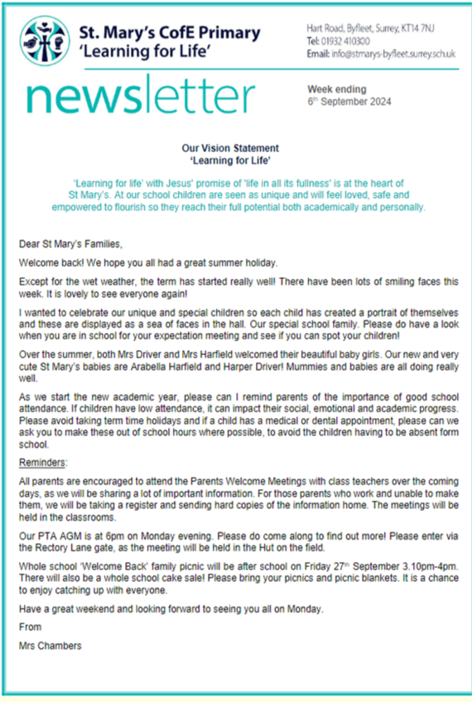

Communications
Communication will be sent out via the office by email.
If you need to contact your child's class teacher, please email
info@stmarys-byfleet.surrey.sch.uk and the message will be passed
on.
Scopay - Deadline reminders for contributions will be sent out 6
weeks before event. As always, if not enough contributions then the
trip is not financially possible.

Slide 15
Progress Reports
End of term progress reports will be sent out termly.

Slide 16
Trips and workshops this year
The Look Out Discovery Centre (Science) – Tuesday 14th October 2025
The Great Fire of London Workshop (History) – Tuesday 13th January 2026
Wisley Gardens (Science) – Tuesday 14th April 2026
Byfleet Library Visit TBC.

Slide 17
Medication
If you haven't already, please make sure all medication is labelled and handed in to the office - epipens/jext pens (2 x pens). This includes all medication (including over the counter). The medication form can be found in
the office or on our school website.

Slide 18
Support and information on the website
HSLW - https://www.stmarys-byfleet.surrey.sch.uk/page/?title=Home+School+Link+Worker&pid=104
SEND - https://www.stmarys-byfleet.surrey.sch.uk/page/?title=SEND+Provision&pid=47
E-Safety - https://www.stmarys-byfleet.surrey.sch.uk/page/?title=Online+Safety&pid=242
The school website is your first port of call before contacting the school.

Slide 19

If you would like to be a class rep, please let your class teacher know.
Please sign up to any days you may be likely to be able to support
children in school on the registers at the back of the classroom before
you leave.
Facebook groups have already been set up ready for this year.
The PTA need you! Sign up with them if you are able to help (see
website).

