Slide 1

Meet our team:
Polar Bears – Mrs O’Connor
Pandas – Mr Evans
Support Staff – Miss Barnes, Miss Boutell and Mrs Ratcliff

Slide 2


Slide 3
Typical School Day
08.35 - School gate opens
08.40 - Morning Task (Handwriting/TTRS)
09.00 - Guided Reading
09.20 - Collective Worship
09.45 - Spelling and English
10.45 - Break
11.00 - Maths
12.00 - Lunch
12.45 - Meditation & Reading for Pleasure
13:00 - Daily PSHE
13.15 - Mastering Number
13:30 - Foundation lessons
14:45 - Class story and reflection.
15.10 - Home Time
Children will walk into class on their own by 8:40 and will be dismissed from the classroom at 3:10pm.

Slide 4
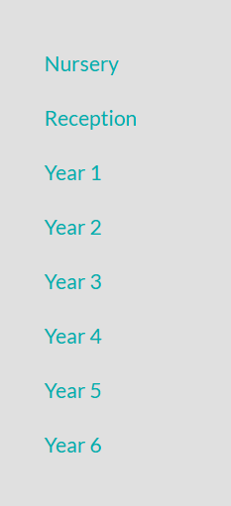
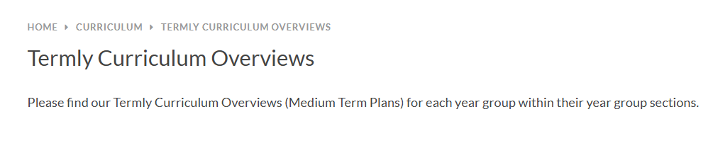
Termly Curriculum Overviews
https://www.stmarys-byfleet.surrey.sch.uk/page/?title=Termly+Curriculum+Overviews&pid=119

Slide 5
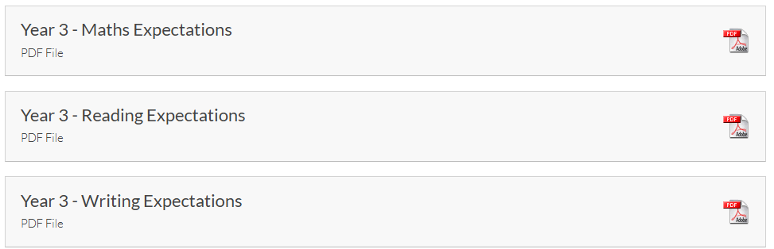
End of Year Expectations
https://www.stmarys-byfleet.surrey.sch.uk/page/?title=End+of+Year+Expectations&pid=513
National Curriculum.

Slide 6
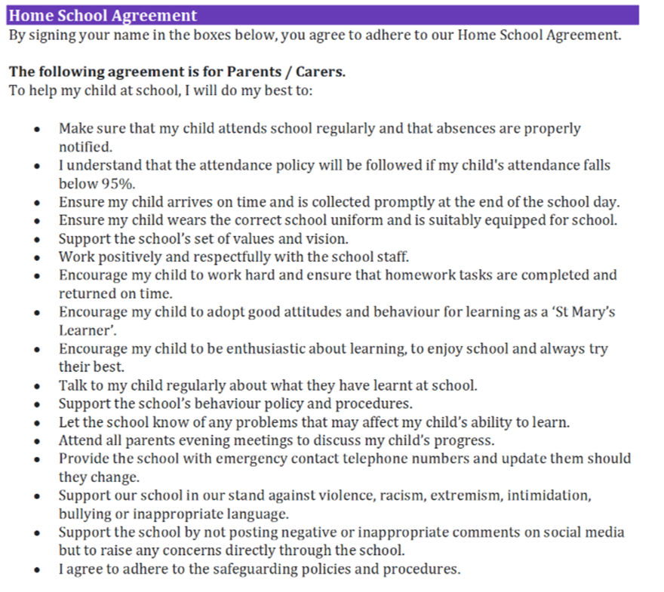
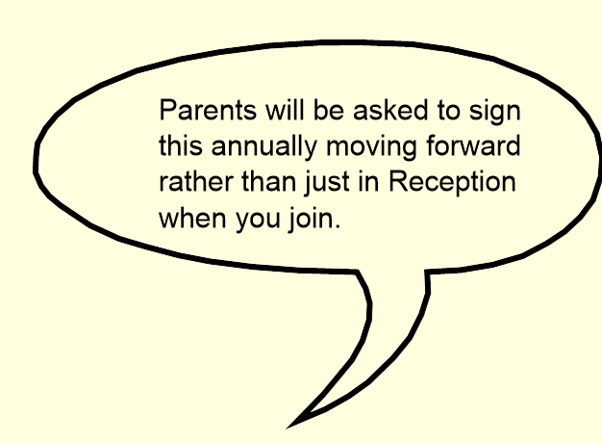

Slide 7
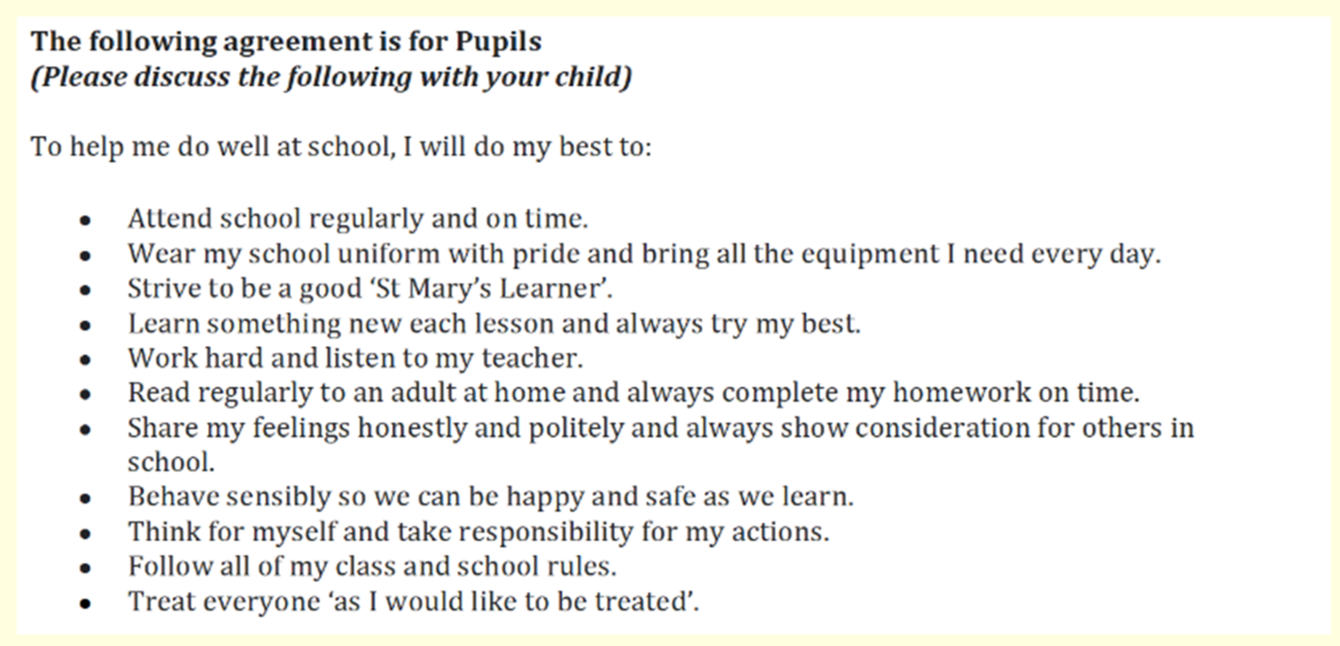
Support meetings will be put in place for families that are finding it challenging to consistently adhere to the home school agreement.
Your home/school agreement will be sent out via email shortly.

Slide 8
Homework expectations
- Reading x 5 weekly
- Weekly spelling list in reading record
- Weekly spelling handwriting
- Comprehension booklet
- Numbots/ TTRS
Homework and reading records to be handed in on a Thursday.
If homework is not completed, children will be expected to do this during their own time at school.
https://ttrockstars.com/
https://play.numbots.com/#/intro

Slide 9
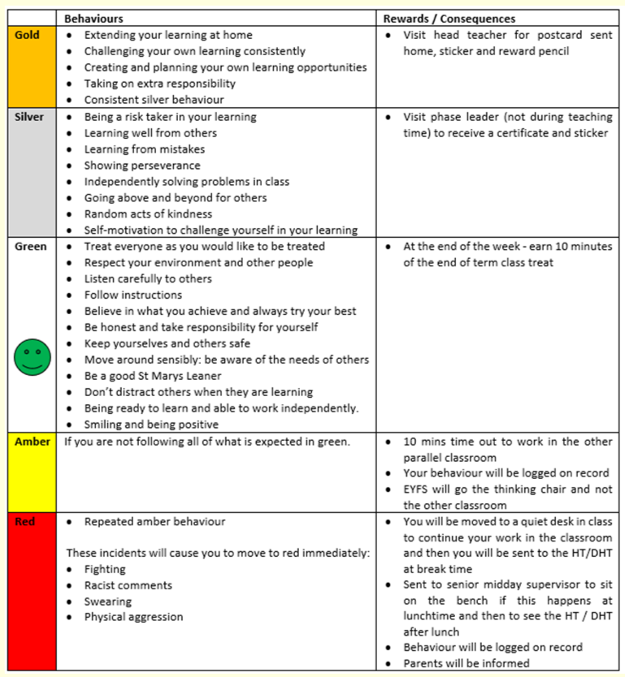
Behaviour Policy
Green time

Slide 10
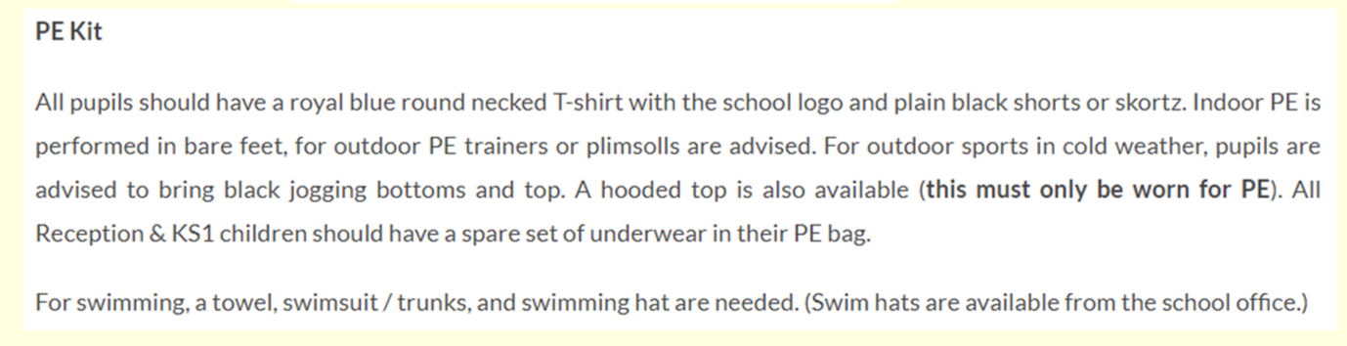
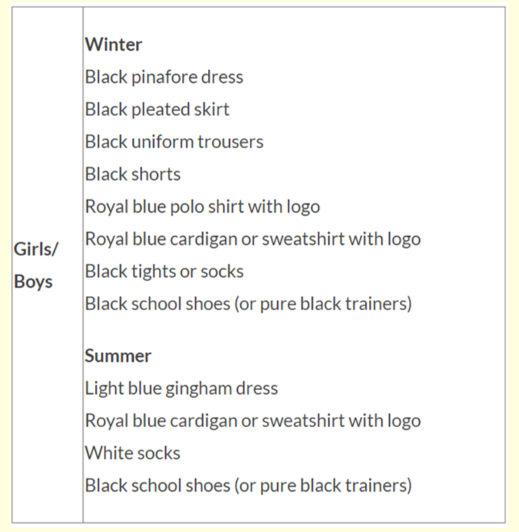
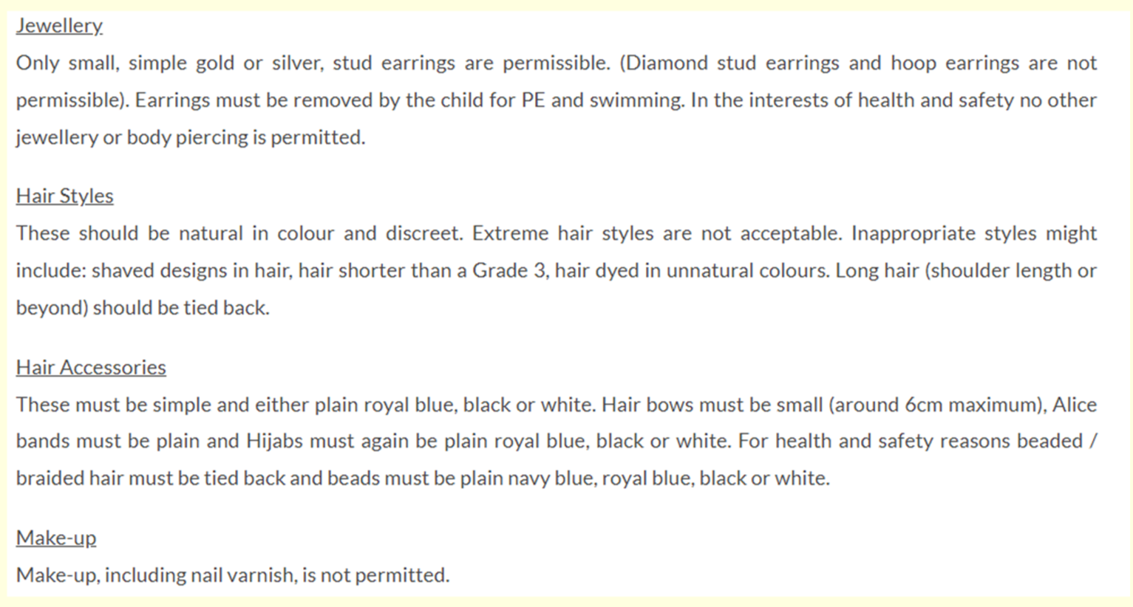
Uniform

Slide 11
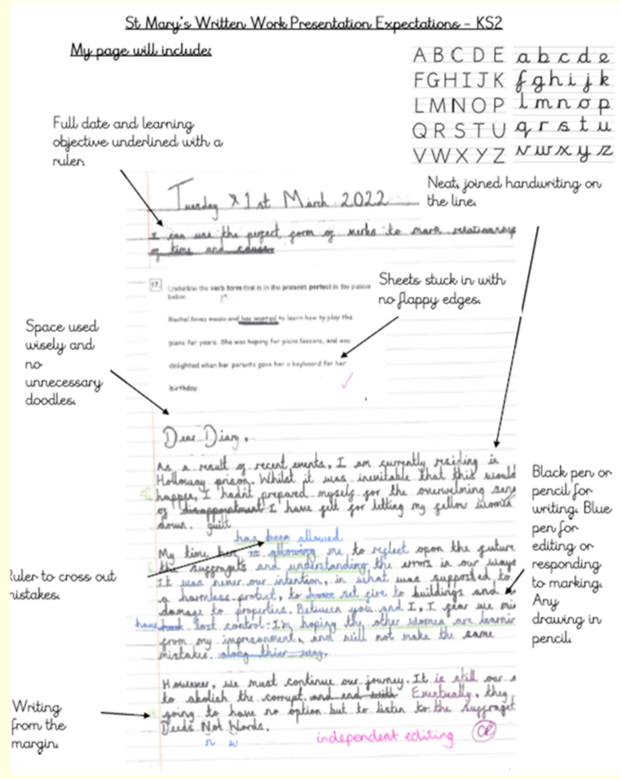
Presentation policy

Slide 12
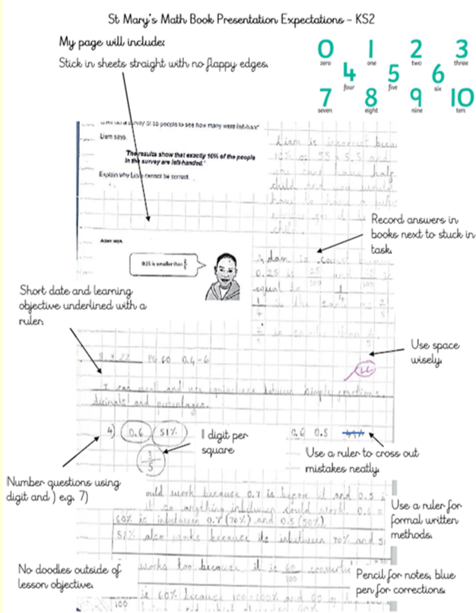
Presentation policy

Slide 13
Rewards
House points
Silver/gold certificates
Whole-school reward stars for values
Star of the Week
Consequences
If the presentation policy is not followed, children will be
expected to rewrite their work
If doodles/drawings/graffiti are found, children will be
sent to a senior leader
Not following behaviour policy

Slide 14
PE afternoons
Indoor PE - Tuesday
Outdoor PE - Thursday (coaches)

Slide 15
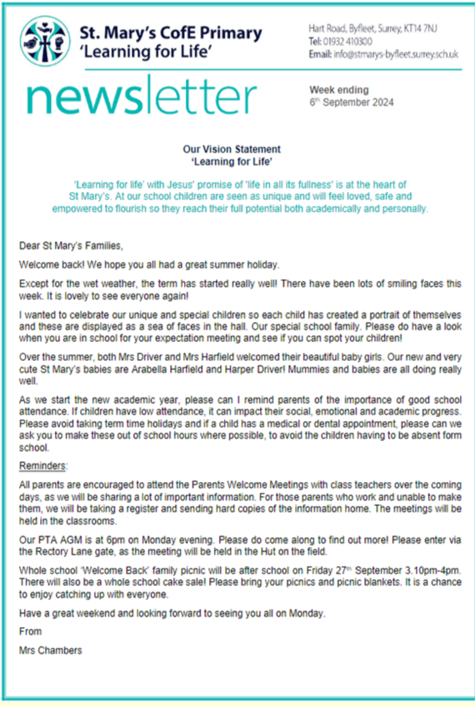

Communications
Communication will be sent out via the office by email.
If you need to contact your child's class teacher, please email
info@stmarys-byfleet.surrey.sch.uk and the message will be passed
on.
Scopay - Deadline reminders for contributions will be sent out 6
weeks before event. As always, if not enough contributions then the
trip is not financially possible.

Slide 16
Progress Reports
End of term progress reports will be sent
out termly.
If you have a child in a year group where
statutory assessments take place (Year
1, Year 4 and Year 6), you will be kept up
to date with their progress towards these.

Slide 17
Trips and workshops this year
Butser Ancient Farm (History) Thursday 9th October 2025
Romans Workshop (History) Located at school Friday 30th January 2026
Brooklands Museum (History) Friday 24th April 2026
Harvest singing at Barnes Wallis TBC
Byfleet Library Visit and Litter Picking TBC.

Slide 18
Medication
If you haven't already, please make sure all
medication is labelled and handed in to the
office - epipens/jext pens (2 x pens). This
includes all medication (including over the
counter). The medication form can be found in
the office or on our school website.

Slide 19
Support and information on the website
HSLW - https://www.stmarys-byfleet.surrey.sch.uk/page/?title=Home+School+Link+Worker&pid=104
SEND - https://www.stmarys-byfleet.surrey.sch.uk/page/?title=SEND+Provision&pid=47
E-Safety - https://www.stmarys-byfleet.surrey.sch.uk/page/?title=Online+Safety&pid=242
The school website is your first port of call before contacting the school.

Slide 20

If you would like to be a class rep, please let your class teacher know.
Please sign up to any days you may be likely to be able to support
children in school on the registers at the back of the classroom before
you leave.
Facebook groups have already been set up ready for this year.
The PTA need you! Sign up with them if you are able to help (see
website).

