Slide 1



Freemantles Sleep Workshop
Justin Price – Executive Headteacher Freemantles School

Slide 2
Introduction and Context
Sleep Scotland 'Sleep Practitioner’ training

Slide 3
What do you know about Sleep?

Slide 4
Sleep Quiz
When you sleep, your body and brain shut down completely in order to rest
When you sleep, you start off in a light sleep at the beginning of the night and gradually go into a deep sleep at the end of the night
I can miss out a few hours sleep and make it up at the weekend
There is a physiological reason why teenagers find it hard to settle at night and get up early
Not getting enough sleep will affect how you do at school
Watching TV in bed won’t affect your sleep
It doesn’t matter what I eat and drink during the day, as long as I brush my teeth before bed
Lack of sleep will make you tired but it will not affect other aspects of your health
Sleep helps you grow
Getting enough sleep will help you avoid obesity
Sleep makes you brainy

Slide 5
What is sleep (for everyone)?
Sleep is
a natural behaviour
a reversible state of reduced awareness and responsiveness to our surroundings
dynamic
Lack of sleep affects our
  emotional wellbeing
  physical health

Slide 6
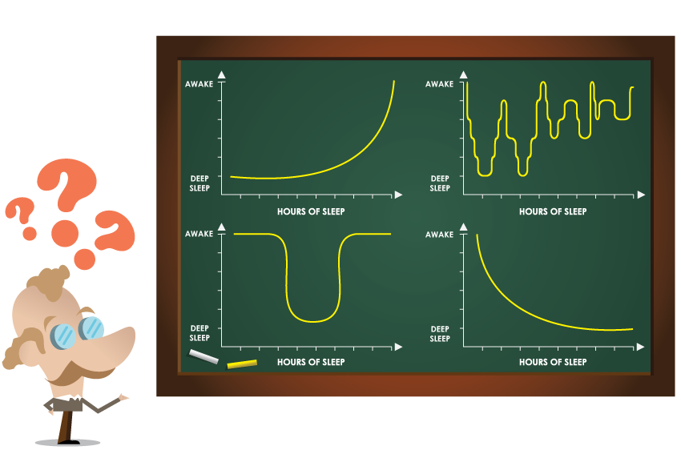
What Does Sleep Look like?

Slide 7
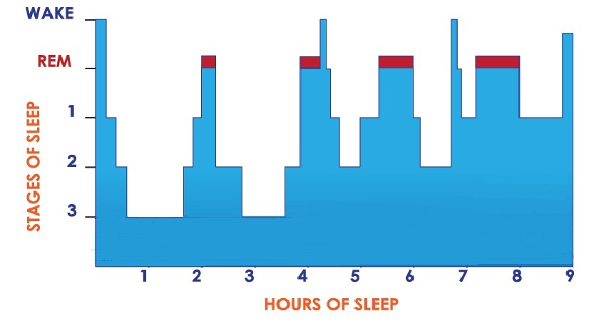
Hypnogram
.

Slide 8
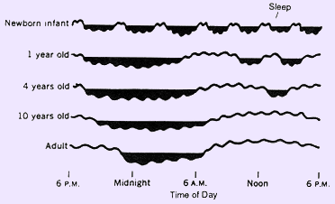
Infant Sleep
Napping is normal in young infants.
Frequent napping in infants plays essential role in establishing long-term memory
New born infants require feeding through the night, so sleep programmes would not start until 11/12 months old

Slide 9
The Body Clock
Virtually every animal has a body clock that governs its circadian rhythm
Our circadian rhythm controls many of our bodily functions including sleep
Our body clock prompts the release of two hormones which affect our sleep:
melatonin
cortisol
Changes that occur during puberty can disrupt a teenager’s body clock and cause it to shift

Slide 10
Zeitgebers
Help keep the body clock in rhythm
Light
Temperature
Meal times
Social activities

Slide 11
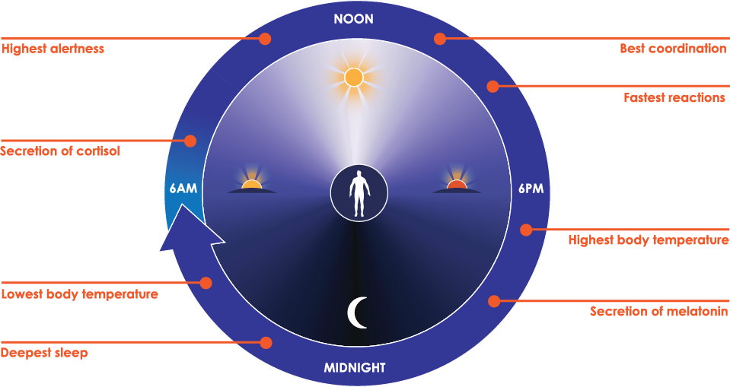
Our body clock: the Circadian Rhythm
Notes:
The body clock manages our:
release of certain hormones
kidney function
muscle response
sleep
temperature
At various times of the day and night we are naturally programmed to do different things:
between 8.00pm and 12 midnight: our temperature falls, our adrenalin levels drop, cortisol level drops, melatonin rises. The effect of this is that we feel less alert; we are beginning to prepare for sleep.
between 12 midnight and 4am: growth hormone is released so we get fat metabolism.
between 4.00am - 8.00am: rising temperature, rising adrenaline, fall in melatonin, rising cortisol.
around 8.00am: blood pressure rises, blood platelets are stickiest. Greatest load on the heart during this time and also the greatest risk of a heart attack.
between 9.00am - 12 noon: body temperature rises with less fatigue, more sensitive to insulin, best performance at complex mental tasks, glucose metabolism.
between 12 noon - 2.00pm: transient fall in adrenaline, we may feel like a nap.
between 3.00pm - 8.00pm: highest temperature, effects of mental fatigue begin to show, our ability to complete complex tasks deteriorates. Our physical performance is at its best, it is often the best time to run a race.

Slide 12
The jet lag effect
Disruption of the body clock
Results in a shift in your body clock
Impacts on your sleep
  Difficulty falling asleep
  Reduced sleep time
  Difficulty waking in the morning

Slide 13
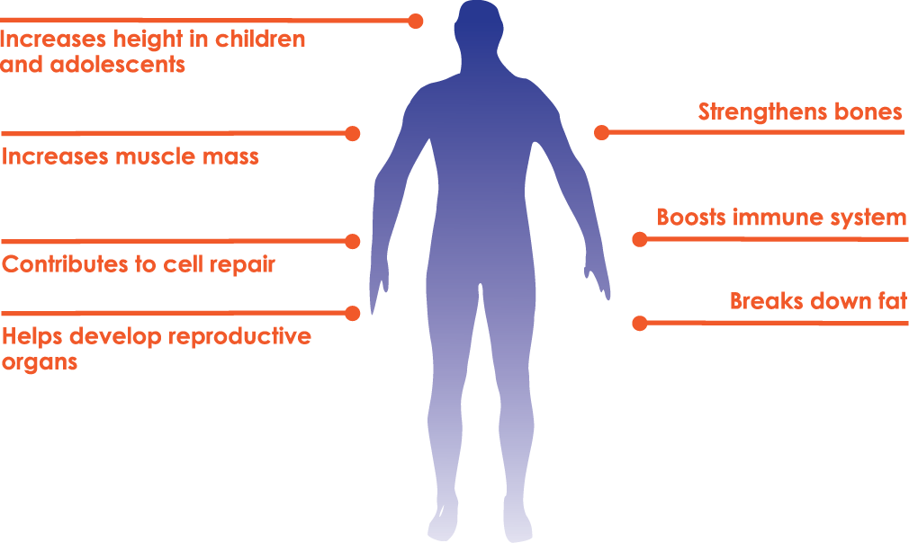
Sleep and physical wellbeing
Our bodies release a cocktail of hormones during sleep that:

Slide 14
Sleep and mental wellbeing
Different learning processes occur during different stages of sleep
Memory consolidation
Vocabulary and pronunciation
Ability to remember words and sounds
emotional growth and understanding
Sleep is crucial for brain development during childhood and adolescence

Slide 15
Common Problems with Sleep that Our Parents identify
Going to sleep very late
Taking a very long time to get to sleep
Waking in the night and not going back to sleep
Waking in night wandering the house / eating
Refusing to sleep anywhere other than parents bed (has still been an issue for some 19yr olds!)
Joining parents in bed when waking in night
Bed wetting in night

Slide 16
Why are children with Autism more likely to have sleep problems?
Communication disorders
Lack of understanding about what the typical routine is, what people usually do and why
Misconceptions about what parents are trying to achieve
Anxiety and ‘replaying’, struggling to wind down
Attempting to make changes to learnt routines is difficult
Good news is these difficulties are all more typically behavioural and can be changed.

Slide 17
Establishing good bedtime practice
What makes a good bedtime environment ?
What makes a good bedtime routine?
Successfully changing routines and behaviours

Slide 18
Good bedtime and sleep environment
Consider :
Lighting and darkness
  Type of lighting if needed
Distractions (toys, gadgets etc)
Tidiness of room
Consistency (throughout the night) – music / noise etc
Temperature of the room
Who else is in the room? And what they do?
Expectations if waking during the night ?

Slide 19
What makes a good bedtime routine
Plan a long time in advance: from when they come in from school?
Gadget time and physical activity vs fine motor activities that help children calm and settle ready for sleep
Meal times vs grazing
However don’t start with an aim for falling asleep at 8 if they are currently never asleep until 10.30!
Baths vs Showers
Create a visual with symbols (school can help) to show the steps and activities to the child

Slide 20
Example of a bedtime routine
Time | Activity
5.30pm | Evening meal
6.00pm | Play time
7.00pm | Quiet play e.g. Jigsaw puzzles, train set Snack
7.20pm | Relaxing bath
7.40pm | Pyjamas, teeth cleaned and into bed
7.45pm | A bedtime story
7.55pm | Cuddles from family member
8.00pm | Leave to settle

Slide 21
Before Bedtime
Avoid afternoon nap after 2pm (escorts!)
No TV or gadgets at least an hour before bed
Quiet play
Snack if required e.g. toast, cereal, milky drink
Avoid sweets/biscuits, fizzy drinks, tea, coffee, hot chocolate
Final Routine should start no more than 1hr before sleep time

Slide 22
Learning to self soothe
After saying goodnight and settling
Parent stay in room with child on chair close to bed
If contact is required a still hand can be placed on the child’s back.
Parent becomes a robot parent – no interactions at this time other than simply being present.
Once child learns to settle like this
– remove hand sit close
- move chair away – little by little until chair outside room
Repeat (at relevant stage you are at) if wakes in night.

Slide 23
Crucial elements of a sleep programme
Clear messages
Consistency. Parents responding the same way each time every time
Re-enforcement
Timing (for parents…need to be ready!)
Diet and Sleep Hygiene

Slide 24
Hard work
Not a magic wand!
Worth the hard graft in the long term!
Plan when you can catch up on sleep
Holidays and weekends (the bad news)
School can help.
This training and support of class staff with resources etc
Individual sleep programme

Slide 26

Questions

