Slide 1







Welcome to
St Mary’s C of E Primary School
SEND Coffee Morning

Slide 2
Senior Case Managers
Case Worker
Triage Officers
Multidisciplinary Team
Social worker
STIPS
Educational Psychologist
SLT
OT
Health
Senior Case Managers
Send Support Advisors
Send Support Advisors
L-SPA Call centre
Admin
Data Analyst
.
Case Workers
Early Years Advisors
EY Commissioning
Team
The group that give advice for the EHCNA panel
ND Advisors
Support settings with ND Training and advice
More exciting things to follow when they are in post…
Support with EHCNA panel
Liaise with schools offering support following panel recommendations.
Offer training and support to SENCOs, schools and trusts
Embed OAP
Attend TAS meetings
Lead L-SPA TAS meetings
TAS Co-ordinators
Work closely with L-SPA Early Intervention Work
Lead and organise TAS meetings
Carry out the 6-week EHCNA process
Support with mediations
Liaise with schools
Attend community events and TAS meetings.
Family Communication Officers
One of L-SPA’s aims is to develop Early Intervention strategies across settings. This is achieved by empowering settings with the knowledge and support found on the Local Offer and through Ordinarily Available Provision in collaboration with our partners.
Reviews data from requests made which informs Early Intervention practice.
Support families following EHCNA parental ‘no to assess’ decisions
Collaborate with partners in the community
Embed OAP
Attend TAS meetings

Slide 3





What does Special Educational Needs mean? (SEND)

Slide 4
Section 20 Children and Families Act 2014 defines a child as having Special Educational Needs (SEN) if he or she "has a learning difficulty or disability which calls for special education provision to be made for him or her".
A child is considered to have a learning difficulty if she or he:
has a significantly greater difficulty in learning than the majority of others of the same age; or
has a disability which prevents or hinders them from making use of facilities of a kind generally provided for others of the same age in mainstream schools or mainstream post-16 settings.

Slide 5



Intervention Model
When the YP needs are complex and need more specialist intervention
EHCP
Support from Specialist Education Services
Additional
Support
Graduated Response
Ordinarily
Available
Provision
Ordinarily Available Provision (OAP) what schools are expected to provide when needed.
Universal Strategies for all. Most young people's needs will be met through this.
High
Quality
Teaching

Slide 6
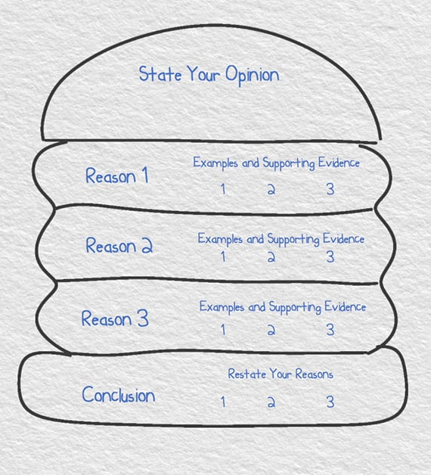



Intervention Model- High Quality Teaching
All children are entitled to High Quality Teaching (HQT) through adapted teaching strategies.
Most children in education will only require support through HQT
High Quality Teaching in Surrey
Notes:
Click on link if needed to show Local Offer- HQT
All staff should deliver high quality inclusive teaching, taking into account the learning needs of all children and using a range of adapted teaching strategies and making reasonable adjustments to accommodate all children.

Slide 7
Areas of Need
The 0-25 SEND Code of Practice (2015) identifies 'four broad areas’ of special educational need and support:
      Communication and interaction
      Cognition and learning
      Social, emotional and mental health
      Sensory and/or physical needs
Notes:
Discuss how often children have needs in more than more area

Slide 8

Intervention Model- Ordinarily Available Provision
Most children with an identified special educational need can have these met through using Ordinarily Available Provision (OAP).
The term ‘Ordinarily Available Provision' comes from the SEND Code of Practice and refers to the support that mainstream schools or settings are expected to provide for a child or young person through their agreed school funding and resource arrangements.
This document is split into the 4 broad areas of need and offers a range of strategies and interventions that can be implemented to support children, forming part of the school’s Local Offer.
Notes:
Outlines specific, additional and time-limited interventions and services provided for some children who are not making expected progress. These are often provided to a group of pupils with similar needs.

Slide 9


Intervention Model- Additional Support
Additional interventions put in place either 1:1 or small group.
Intervention progress monitored through Individual Education Plans/ Support Plans
Child might be added to SEND Register- if less than expected progress being made.
Advice sought from professionals if required: for example, Speech and Language therapist, Specialist Teacher for Inclusive Practice (STIPS) .
Notes:
There are some school-age children who require additional teaching and support alongside the standard curriculum and schedule.
These children, if they are making less than expected progress, are added to the SEND register and identified as requiring SEND Support.
This is a dynamic list that children can be added to or removed from at any time, depending on how appropriate it is to their needs.
The SEN Register must be managed following guidance from the SEND Code of Practice, but it is not a guarantee of specific provision for your child.

Slide 10
What Ordinarily Available Provision and Additional Support looks like at St Mary’s

Slide 11
Social, Emotional and Mental Health | Cognition and Learning
ELSA Counselling Play therapy Nurture group Indoor buddies group Lego therapy Attention Bucket Social stories Comic strip conversations Home-school Link Worker | Chrome book Pre-teach Scaffolding Sand-timers, concrete resources Precision teaching Tutoring Daily readers 5 minute box Number box Nessy Numbots Power of 2 Toe by Toe
Communication and Interaction | Sensory and Physical
Elklan Developing phonological awareness Ultimate guide to phonological awareness Semantic links PALS social skills programme Language for thinking Socially speaking ALD boards, visual timetables, now-next boards, symbols | Handies Sensory Circuits Movement breaks Resources e.g. move ‘n’ sit cushion, ear defenders, fidget tools, chair-bands, pencil grips, chew tools Sensory room Class sensory box

Slide 12
Specialist Support
Specialist services offer support for children with complex needs who require a high level of additional support, identified following assessments. Assessments can be carried out by school and or other services in Surrey. Typically support will be individual and longer-term following the assess, plan, do, review approach [APDR]
Specialist professionals will be involved in supporting the school, if Ordinarily Available Provision and Additional Support is not enabling the child to make progress.
It is at this point that schools, parents and/ or the young person may consider apply for an Education Health and Care Plan Assessment.

Slide 13

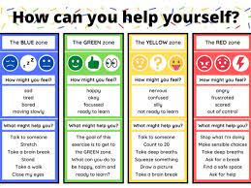
Surrey Services that can offer support to schools and families- Additional and Specialist Support
STIPs- Specialist Teachers for Inclusive Practices
Speech and Language Therapy
ASD Outreach
REMA- Race Equality and Minority Achievement
Educational Psychology
Access 2 Education
Surrey Online School
Mindworks
Surrey Virtual School
Physical and Sensory Support (including hearing and vision)
Occupational Therapy
Physiotherapy
Children with Disabilities Team
School nurses service

Slide 14

What is an Education, Health and Care Plan? (EHCP)
Education, Health and Care (EHC) plans are for children and young people with special educational needs and/ or disabilities (SEND), who need more support than mainstream early years settings, schools and colleges can normally provide.

Slide 15
Why might children need an Education, Health and Care Plan? (EHCP)
EHCPs are for children and young people aged 0 to 25 years, who need greater specialist support than their school or other setting can provide. The setting will have exhausted all possible support within their Local Offer.

Slide 16
The school or college, young person (if over 16) or the parent/carer can apply for an EHCP when…
The school has provided all possible support it can within the Local Offer- HQT and Ordinarily Available Provision (OAP).
The young person is on the SEND Register.
The young person has undergone at least 3 Assess-Plan-Do-Review cycles to monitor their progress- usually one each term.
Evidence of a support plan (SEND Support Arrangements- SSA).
The school has made referrals to all appropriate support services and there is evidence advice has been followed.
There has been close liaison between home, the young person and school and they have worked together to ensure the above has happened.
When can an EHCP be applied for?

Slide 17




Talk to your child's key worker or teacher if you're worried they may have additional needs and/or disabilities
Talk to the educational setting's Special Educational Needs Co-Ordinator (SENCO) about the provision being put in place.
Ensure that the education setting have exhausted the Ordinarily Available Provision
Steps to take before applying for an EHCNA:

Slide 18
How do you apply for an EHCP?
Before the Local Authority (LA) can issue an EHCP, an Education, Health and Social Care Needs Assessment (EHCNA) is carried out.

Slide 19
It is helpful to have a joint application between home and school so that all the information required to make a decision has been collated and discussed.
How do you apply for an EHCP?

Slide 20
Each member of the panel looks for the following when making a decision to assess for an EHCP:
Evidence that the child or young person has SEND
A costed provision map that shows need that is additional to or different from the targeted provision (OAP)
3 cycles of the Assess, Plan, Do, Review and the impact
Specialist support from professionals has been implemented which has had little to no progress
Any social care needs
What happens during the EHCNA?
Once the evidence has been submitted, it will be reviewed within 6 weeks by a panel of professionals which could include: an Educational Psychologist, Social Worker, member of L-SPA team, STIP, Case Officer and SALT.

Slide 21
If the panel agrees that there is enough evidence to suggest a child has a SEND, you will receive a ‘Yes to Assess’ response.
What if the panel agrees to an EHCNA?
An EHC needs assessment does not always lead to a young person receiving an EHCP. If the LA decides not to issue a plan, the school and family still receives the professionals’ advice, which should be implemented to support the young person further.
Families have the right to appeal if not satisfied with the LA’s decision.
The child will then be referred to the area team and appropriate professionals’ assessments will be sought to decide if an EHCP should be issued.

Slide 22
The LA will say “No to Assess” if:
There is not enough evidence that the young person has an SEN
    This is why having a joint application from Education and Families provides a greater holistic overview of the child
The young person’s needs can be met within Ordinarily Available Provision
The provision map does not show additional to and different from Ordinarily Available Provision
Specialist support/ advice has not been sought from professionals, for example: Speech and Language therapy, Autism Outreach, STIPs
Families have the right to appeal if not satisfied with the LA’s decision.
What if the panel does not agree to an EHCNA?

Slide 23

Surrey Local Offer
The Local Offer website
The Local Offer website provides comprehensive information about the range of services and provisions available to children and young people in Surrey with special educational needs and disabilities (SEND).

Slide 24


Slide 25
Useful Links
Surrey Local Offer
Provision by SEN that schools could offer
SEND Advice Surrey and SENDIAS - SEND Advice Surrey
Further information about SEN and EHCPs
SEN guide for parents and carers
Top 10 tips for families

